Slide 1
openFDA Baby Safe RX
Initial User Research Findings
6/19/15

Slide 2
Agenda
Research Overview
Key Findings
Recommendations

Slide 3
Research Overview

Slide 4
Goals & Objectives
01
To determine if pregnant women and nursing mothers would use an online tool to search US Food and Drug Administration data regarding pregnancy and nursing risks for specific prescription drugs
03
To learn more about what information is most important to women looking for pregnancy and nursing risks related to specific prescription drugs
02
To understand how users would prefer to search for the information pregnancy and nursing risks for specific prescription drugs
04
To gather common scenarios from women who have dealt with prescription drug concerns while pregnant

Slide 5
Research Methodology
On June 18th and 19th a survey was conducted with 89 respondents.
Respondents represented the target audience for Safe Baby RX:
Expectant mothers
Nursing mothers
The survey was launch via social media and email using Survey Monkey.
A researcher reviewed all results and individual feedback from survey respondents.

Slide 6
Findings

Slide 7
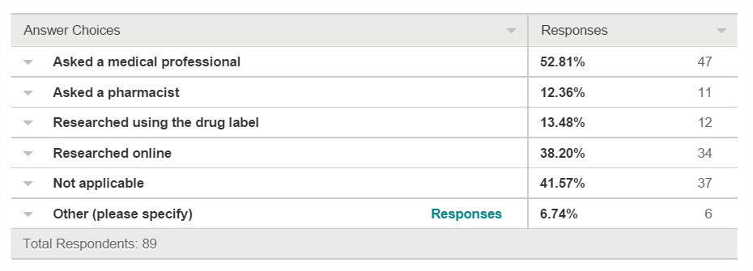
Findings
The majority of women surveyed would use an online tool provided by the US FDA to get information about drug safety related to pregnancy
92% of women indicated they would
Women have a variety of methods they use now to get this type of information.

Slide 8
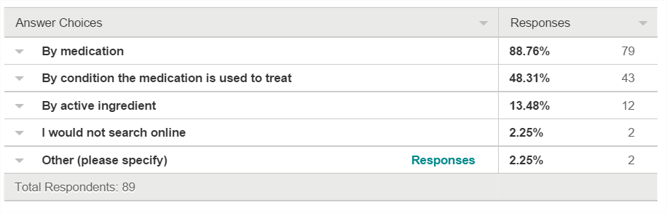
Findings
Women would prefer to search by drug name. Medical condition would be their secondary means of preferred search.

Slide 9
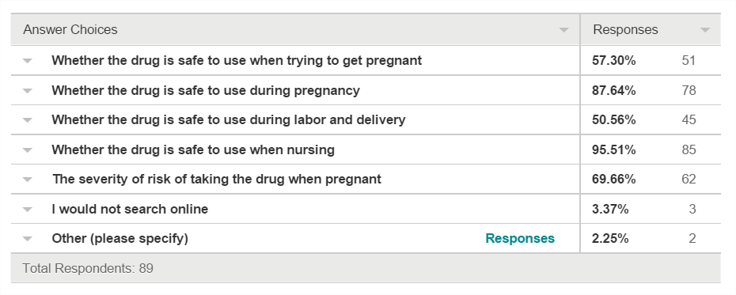
Findings
Women are interested in a variety of information about pregnancy risks that are available in the FDA data set.

Slide 10
What pregnant women experience
Trying to make informed decisions about prescription drug use when pregnant is a challenge for women.
“This happened several times to me… When nursing I had several instances--an antidepressant, anti-fungal for shingles, antibiotics for sinus infection, etc. Used LactMed and Infant Risk Center apps, as well as spoke with physician, pharmacist, lactation consultant, etc”
“I had severe morning sickness. I had the option to take Zofran, but didn't after reading many online sites with stories from women who had issues with the drug and talking to my pharmacist friends.”
“To treat anxiety and depression I took Zoloft through the 2nd and 3rd trimester. I discussed the class of medication with my midwife as well as research that showed risks during pregnancy. ultimately we decided, based on past mental health history (PPD) that it was best to take it during pregnancy.”

Slide 11
Recommendations

Slide 12
Summary of Recommendations
Create a tool that allows consumers to research the pregnancy and nursing risk information from drug labeling data supplied by the US FDA to allow them to make educated decisions about the possible risks related to prescription drug use and prepare for conversations with health care providers.
Site should leverage and promote credibility of US FDA because user research indicates a high level of trust in user information
Information should be comprehensive for as many prescription drugs and risks as possible
Site functionality should be intuitive and highly learnable since use will be occasional and
User experience should be friendly and inviting because user research indicates high stress levels when researching this content
Site should provide medication alternatives for consumers to consider if there is more than one option to treat their medical condition

